Slide 1
Red-Black Trees

Slide 2
Red-black trees: Overview
Red-black trees are a variation of binary search trees to ensure that the tree is balanced.
Height is O(lg n), where n is the number of nodes.
Operations take O(lg n) time in the worst case.

Slide 3
Red-black Tree
Binary search tree + 1 bit per node: the attribute color, which is either red or black.
All other attributes of BSTs are inherited
All empty trees (leaves) are colored black.
We use a single sentinel, nil, for all the leaves of red-black tree T, with color[nil] = black.
The root’s parent is also nil[T ].

Slide 4
Red-black Properties
Color property: Every node is either red or black.
Root property: The root is black.
External property: Every leaf (nil) is black.
Internal property: If a node is red, then both its children are black.
Depth property: For each node, all paths from the node to descendant leaves contain the same number of black nodes.

Slide 5
Red-black Tree – Example
26
Remember: every internal node has two children, even though nil leaves are not usually shown.
17
41
nil
nil
30
47
38
50
nil
nil
nil
nil
nil

Slide 6
Operations on RB Trees
All operations can be performed in O(lg n) time.
The query operations, which don’t modify the tree, are performed in exactly the same way as they are in BSTs.
Insertion and Deletion are not straightforward.

Slide 7
Insertion in RB Trees
Insertion must preserve all red-black properties.
Basic steps:
Use Tree-Insert from BST (slightly modified) to insert a node x into T.
Procedure RB-Insert(x).
Color the node x red.
Fix the modified tree by re-coloring nodes and performing rotation to preserve RB tree property.
Procedure RB-Insert-Fixup.

Slide 8
Insertion
RB-Insert(T, z)
y ← nil[T]
x ← root[T]
while x ≠ nil[T]
do y ← x
if key[z] < key[x]
then x ← left[x]
else x ← right[x]
p[z] ← y
if y = nil[T]
then root[T] ← z
else if key[z] < key[y]
then left[y] ← z
else right[y] ← z
RB-Insert(T, z) Contd.
left[z] ← nil[T]
right[z] ← nil[T]
color[z] ← RED
RB-Insert-Fixup (T, z)

Slide 9
Insertion – Fixup

Slide 10
Insertion – Fixup
Problem: we may have one pair of consecutive reds where we did the insertion.
Solution: rotate it up the tree and away… Three cases have to be handled…

Slide 11
Case 1 – uncle y is red
p[p[z]]
new z
C
C
p[z]
y
A
D
A
D
z
α
δ
ε
α
δ
ε
B
B
z is a right child here.
Similar steps if z is a left child.
β
γ
γ
β
p[p[z]] (z’s grandparent) must be black, since z and p[z] are both red and there are no other violations of property 4.
Make p[z] and y black ⇒ now z and p[z] are not both red. But property 5 might now be violated.
Make p[p[z]] red ⇒ restores property 5.
The next iteration has p[p[z]] as the new z (i.e., z moves up 2 levels).

Slide 12
Case 2 – uncle y is black, z is a right child
C
C
p[z]
p[z]
A
δ
y
B
δ
y
z
α
z
A
γ
B
γ
α
β
β
Left rotate around p[z], p[z] and z switch roles ⇒ now z is a left child, and both z and p[z] are red.
Takes us immediately to case 3.

Slide 13
Case 3 – y is black, z is a left child
C
B
p[z]
B
A
C
δ
y
z
α
β
γ
δ
A
γ
α
β
Make p[z] black and p[p[z]] red.
Then right rotate on p[p[z]]. Ensures property 4 is maintained.
No longer have 2 reds in a row.
p[z] is now black ⇒ no more iterations.

Slide 14
Insertion – Fixup
RB-Insert-Fixup (T, z)
while color[p[z]] = RED
do if p[z] = left[p[p[z]]]
then y ← right[p[p[z]]]
if color[y] = RED
then color[p[z]] ← BLACK // Case 1
color[y] ← BLACK // Case 1
color[p[p[z]]] ← RED // Case 1
z ← p[p[z]] // Case 1

Slide 15
RB-Insert-Fixup(T, z) (Contd.)
else if z = right[p[z]] // color[y] ≠ RED
then z ← p[z] // Case 2
LEFT-ROTATE(T, z) // Case 2
color[p[z]] ← BLACK // Case 3
color[p[p[z]]] ← RED // Case 3
RIGHT-ROTATE(T, p[p[z]]) // Case 3
else (if p[z] = right[p[p[z]]])(same as 10-14
with “right” and “left” exchanged)
then z ← p[z] // Case 2
RIGHT-ROTATE(T, z) // Case 2
color[p[z]] ← BLACK // Case 3
color[p[p[z]]] ← RED // Case 3
LEFT-ROTATE(T, p[p[z]]) // Case 3
color[root[T ]] ← BLACK

Slide 16
Algorithm Analysis
O(lg n) time to get through RB-Insert up to the call of RB-Insert-Fixup.
Within RB-Insert-Fixup:
Each iteration takes O(1) time.
Each iteration but the last moves z up 2 levels.
O(lg n) levels ⇒ O(lg n) time.
Thus, insertion in a red-black tree takes O(lg n) time.
Note: there are at most 2 rotations overall.

Slide 17
Height of a Red-black Tree
Height of a node:
h(x) = number of edges in a longest path to a leaf.
Black-height of a node x, bh(x):
bh(x) = number of black nodes (including nil[T ]) on the path from x to leaf, not counting x.
Black-height of a red-black tree is the black-height of its root.
By Property 5, black height is well defined.

Slide 18
Height of a Red-black Tree
h=4
bh=2
Example:
Height of a node:
h(x) = # of edges in a longest path to a leaf.
Black-height of a node bh(x) = # of black nodes on path from x to leaf, not counting x.
How are they related?
bh(x) ≤ h(x) ≤ 2 bh(x)
26
h=3
bh=2
17
h=1
bh=1
41
h=2
bh=1
h=2
bh=1
30
47
h=1
bh=1
38
h=1
bh=1
50

Slide 19
Lemma “RB Height”
Consider a node x in an RB tree: The longest descending path from x to a leaf has length h(x), which is at most twice the length of the shortest descending path from x to a leaf.
Proof:
# black nodes on any path from x = bh(x) (prop 5)
# nodes on shortest path from x, s(x). (prop 1)
But, there are no consecutive red (prop 4),
and we end with black (prop 3), so h(x) ≤ 2 bh(x).
Thus, h(x) ≤ 2 s(x).

Slide 20
Bound on RB Tree Height
Lemma: The subtree rooted at any node x has ≥ 2^{bh(x)}–1 internal nodes.
Proof: By induction on height of x.
Base Case: Height h(x) = 0 ⇒ x is a leaf ⇒ bh(x) = 0. Subtree has 2⁰–1 = 0 nodes.
Induction Step: Height h(x) = h > 0 and bh(x) = b.
Each child of x has height h - 1 and black-height either b (child is red) or b - 1 (child is black).
By ind. hyp., each child has ≥ 2^{bh(x)– 1}–1 internal nodes.
Subtree rooted at x has ≥ 2 (2^{bh(x) – 1} – 1)+1 = 2^{bh(x)} – 1 internal nodes. (The +1 is for x itself.)

Slide 21
Bound on RB Tree Height
Lemma: The subtree rooted at any node x has ≥ 2^{bh(x)}–1 internal nodes.
Lemma: A red-black tree with n internal nodes has height at most 2 lg(n+1).
Proof:
Let bh be the black height of the root (tree) and h be the height of the root (tree)
By the above lemma, n ≥ 2^{bh} – 1,
and since bh ≥h/2, we have n ≥ 2^{h/2} – 1.
⇒ h ≤ 2 lg(n + 1).

Slide 22
2-3 Trees

Slide 23
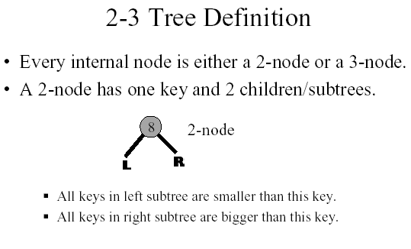

Slide 24
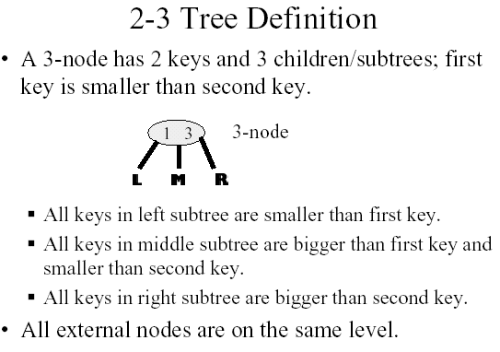

Slide 25
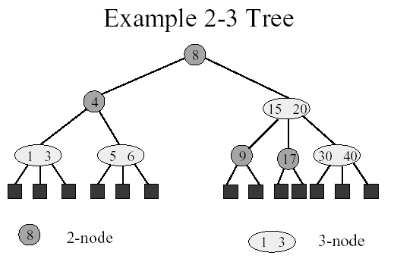

Slide 26
2-3 Tree vs. Binary Tree
A 2-3 tree is not a binary tree since a node in the 2-3 tree can have three children.
A 2-3 tree does resemble a full binary tree.
If a 2-3 tree does not contain 3-nodes, it is like a full binary tree since all its internal nodes have two children and all its leaves are at the same level.

Slide 27
Cont.
If a 2-3 tree has three children, the tree will contain more nodes than a full binary tree of the same height.
Therefore, a 2-3 tree of height h has at least 2^h - 1 nodes.
In other words, a 2-3 tree with N nodes never has height greater then log (N+1), the minimum height of a binary tree with N nodes.

Slide 28
Example of a 2-3 Tree
The items in the 2-3 are ordered by their search keys.
50 90
20
70
120 150
10
30 40
60
80
100 110
160

Slide 29
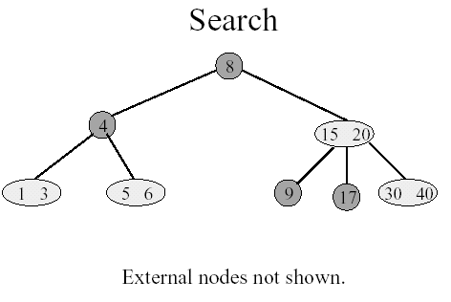

Slide 30
The Advantages of the 2-3 trees
Less Height → Less no. of comparisons
Maintaining the balance of a 2-3 tree is relatively simple than maintaining the balance of a binary search tree .

Slide 31
Consider the two trees contain the same data items.
50
60
30
90
30
70 90
10
50
80
100
10 20
40
60
80
100
20
40
70
A balanced binary search tree
A 2-3 tree

Slide 32
Inserting into a 2-3 Tree
Perform a sequence of insertions on a 2-3 tree is more easier to maintain the balance than in binary search tree.
Example:

Slide 33
60
30
90
30
50
80
100
20
40
70
60
39
30
90
38
37
10
50
80
100
36
35
20
40
70
34
1) The binary search tree after a sequence of insertions

Slide 34
37
34
50
30
35
39
70 90
10 20
36
38
40
60
80
100
2) The 2-3 tree after the same insertions.

Slide 35
Inserting into a 2-3 Tree (cont.)
Insert 39. The search for 39 terminates at the leaf <40>. Since this node contains only one item, can simply insert the new item into this node
50
30
70 90
10 20
39
40
60
80
100

Slide 36
Inserting into a 2-3 Tree (cont.)
Insert 38: The search terminates at <39 40>. Since a node cannot have three values, we divide these three values into smallest(38), middle(39), and largest(40) values. Now, we move the (39) up to the node’s parent.
30
39
10 20
38
40

Slide 37
Inserting into a 2-3 Tree (cont.)
Insert 37: It’s easy since 37 belongs in a leaf that currently contains only one values, 38.
30 39
10 20
37
38
40

Slide 38
The Insertion Algorithm
To insert an item I into a 2-3 tree, first locate the leaf at which the search for I would terminate.
Insert the new item I into the leaf.
If the leaf now contains only two items, you are done. If the leaf contains three items, you must split it.

Slide 39
The Insertion Algorithm (cont.)
Spliting a leaf
a)
P
M P
S M L
S
L
b)
P
P M
S M L
S
L

Slide 40
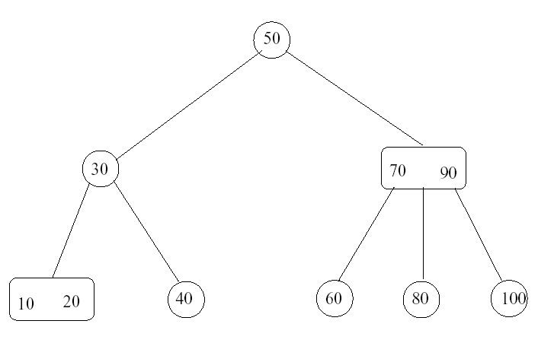
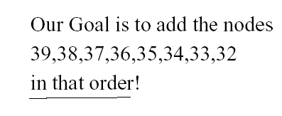

Slide 41
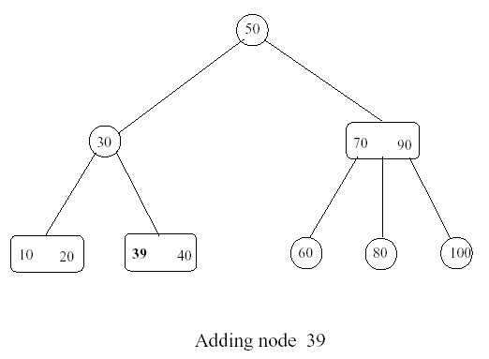
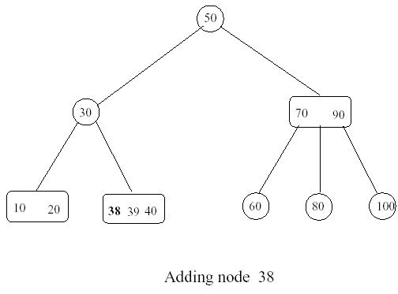

Slide 42
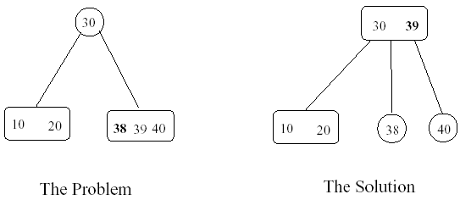
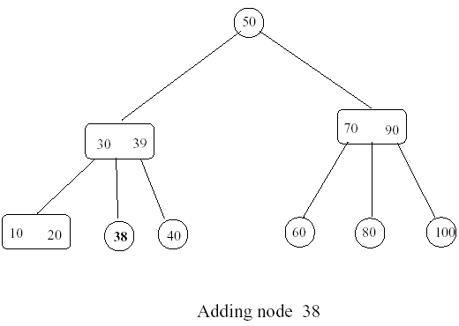

Slide 43
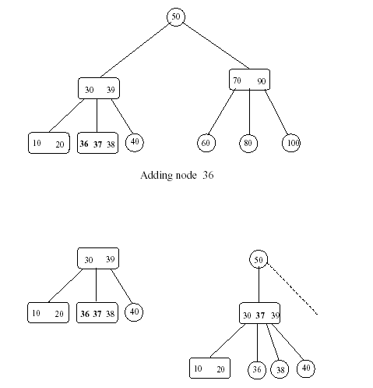

Slide 44
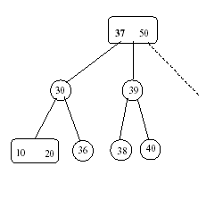
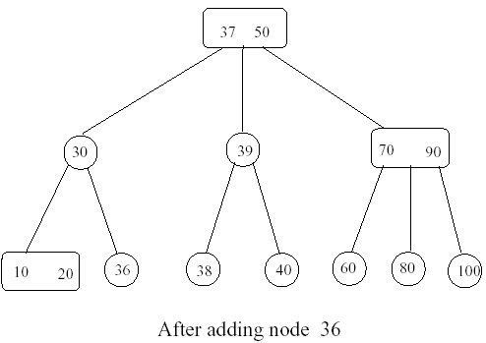

Slide 45
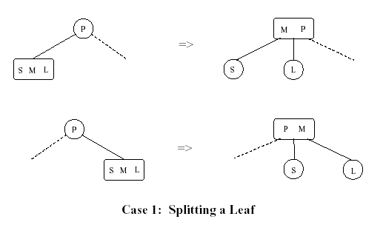

Slide 46
